Slide 1


Crop Fertilizer Recommendation and Plant Disease Detection Using ResNet
AgriSmart is a comprehensive web application developed to assist farmers in optimizing crop selection, fertilizer use, and plant disease management. This project, undertaken by Aadarsh (12112120) under the supervision of Mr. Ankit Kumar Jain at the National Institute of Technology, Kurukshetra, leverages advanced technologies including machine learning and deep learning to provide tailored agricultural solutions. The application offers three primary services: Crop Recommendation, Fertilizer Suggestion, and Disease Detection, with the latter utilizing the powerful ResNet architecture for accurate plant health diagnosis.
by Aadarsh(12112120)

Slide 2

Project Overview and Motivation
Address Agricultural Challenges
AgriSmart aims to tackle key issues in agriculture such as optimizing crop selection, managing soil nutrients, and detecting plant diseases.
Empower Farmers
The project is motivated by the need to provide farmers with accessible, technology-driven solutions to make data-driven decisions.
Improve Productivity
By offering tools for crop recommendation, fertilizer suggestion, and disease detection, AgriSmart seeks to enhance agricultural productivity and sustainability.
Bridge Technology Gap
The application aims to make advanced agricultural technologies accessible to farmers who may have limited access to such tools and expertise.

Slide 3
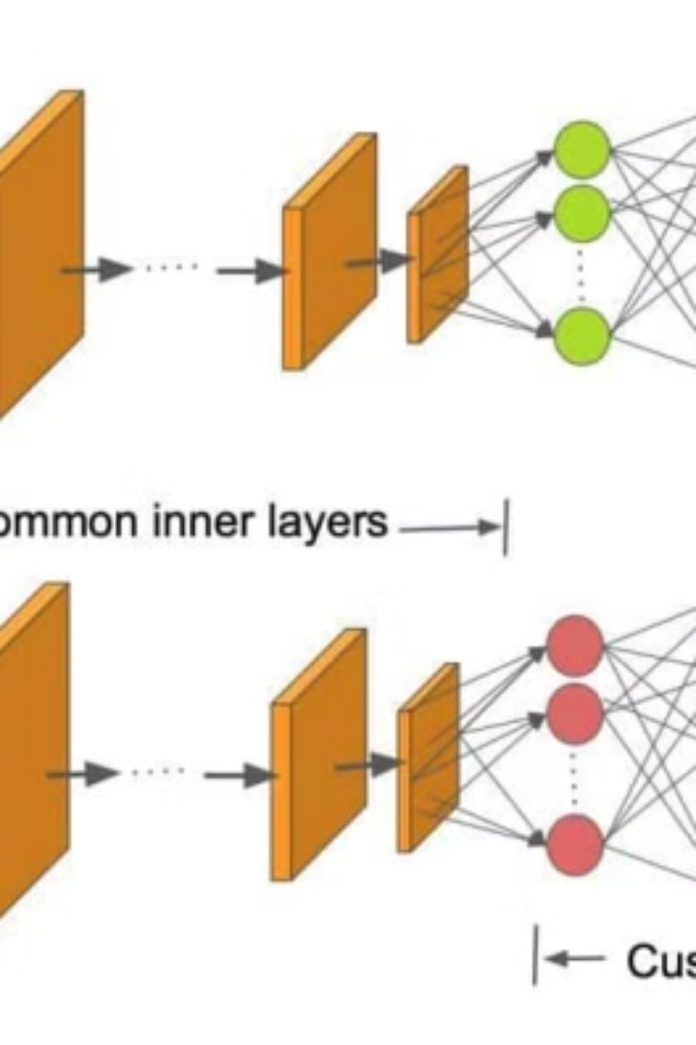
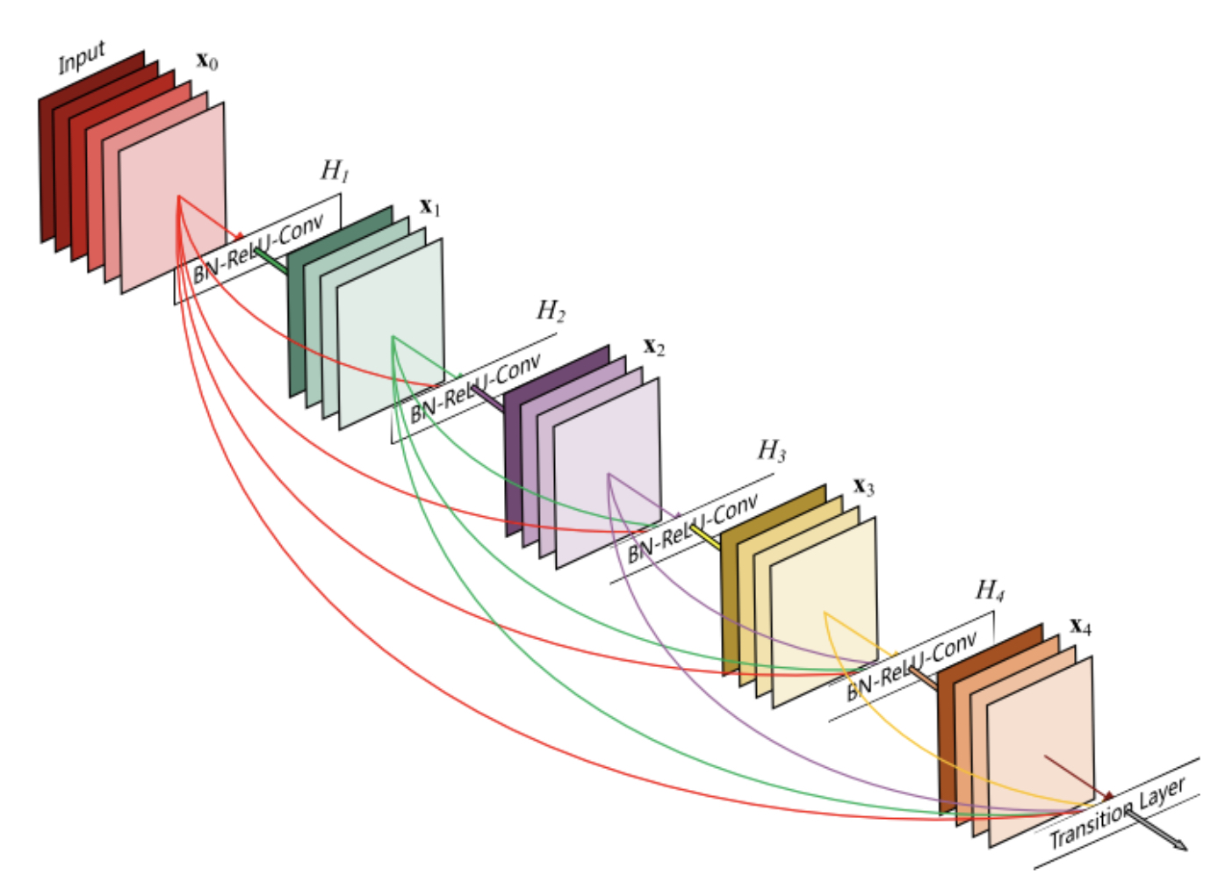
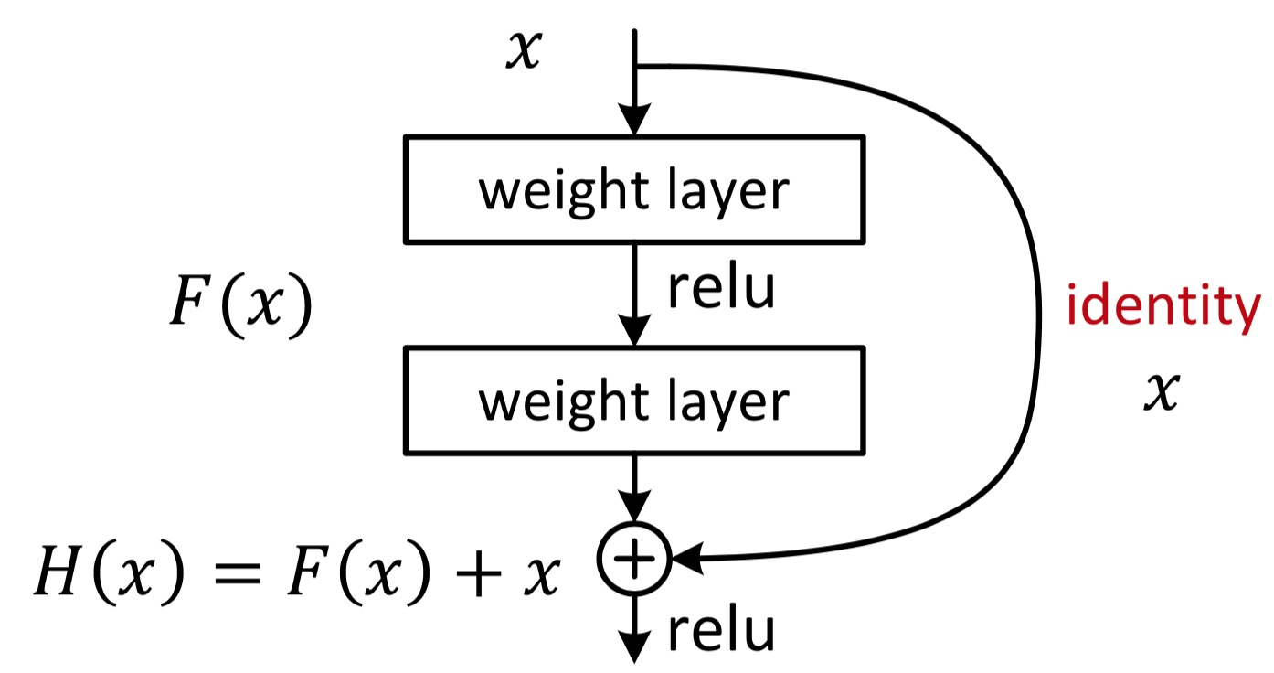
ResNet Architecture
1
Introduction of ResNet
Residual Neural Network (ResNet) was introduced in 2015 by Kaiming He et al. to address challenges in training deep neural networks.
2
Residual Learning Framework
ResNets use a deep residual learning framework with shortcut connections, allowing the network to adapt to residual mapping instead of underlying mapping.
3
Variants and Depths
ResNets come in various depths, such as ResNet-18, ResNet-32, and ResNet-50, with ResNet-50 being a mid-sized variant known for its efficiency in image classification tasks.

Slide 4
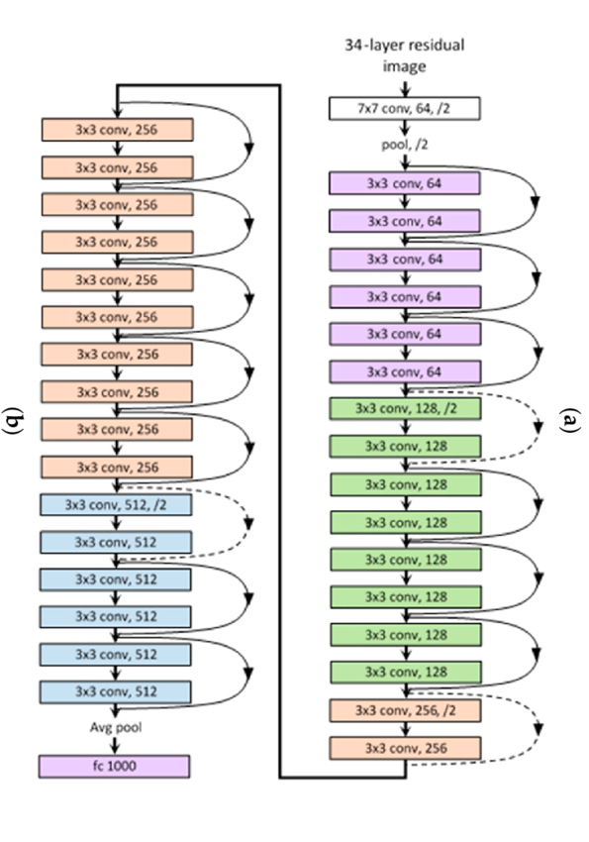




Application Flow
User Input
Farmers provide necessary inputs such as soil nutrient values, location, or plant leaf images depending on the service required.
Data Processing
The application processes the input data, analyzing soil nutrients, weather data, or preprocessing plant images for analysis.
Model Invocation
Appropriate machine learning or deep learning models are invoked to analyze the processed data and generate recommendations or diagnoses.
Output Presentation
Results are presented to the user, providing crop recommendations, fertilizer suggestions, or plant disease diagnoses with preventive measures and treatment options.

Slide 5
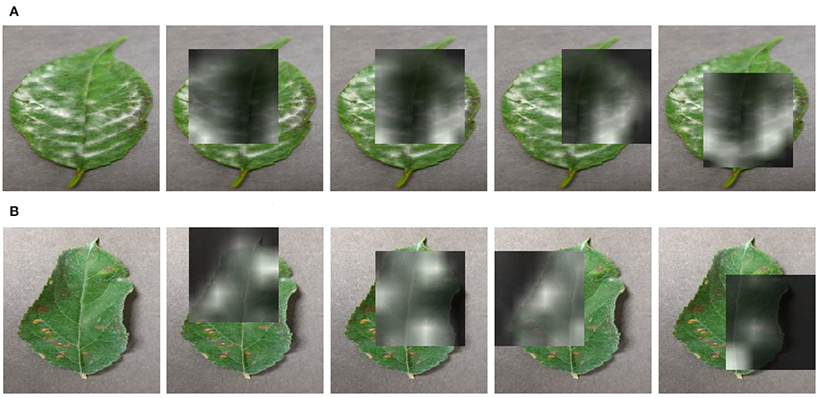
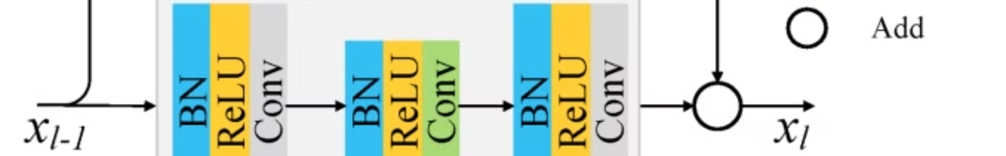
Feature Extraction in Disease Detection
1
Image Preprocessing
2
ResNet Model Application
Before feature extraction, leaf images undergo preprocessing including resizing, normalization, and noise reduction to standardize input for analysis.
The ResNet model extracts features such as texture, color, and shape from preprocessed images, which are critical indicators of plant health.
3
Classification Process
4
Efficiency and Accuracy
Extracted features are fed into classification layers for analysis to determine the presence of disease, distinguishing between healthy and diseased plants.
Feature extraction condenses image data into representative attributes, improving diagnosis accuracy and processing speed while enabling distinction between subtle disease differences.

Slide 6
Validation Accuracy and Loss
Validation Accuracy
Validation Loss
Balancing Metrics
Represents the proportion of correctly classified plant leaf images in the validation set. High validation accuracy indicates good generalization to unseen data. Trends are monitored to detect potential overfitting.
Quantifies the difference between predicted outputs and actual outputs in the validation set. Lower validation loss indicates more accurate predictions. Monitored alongside accuracy to ensure robust model performance.
Optimal model performance is achieved by balancing high accuracy with low, consistent validation loss, indicating robust generalization to new data.

Slide 7
Prediction Systems
Crop Recommendation System
Fertilizer Suggestion System
Versatility
Both systems employ predictive algorithms fine-tuned to handle variability in soil and weather conditions across different regions, making AgriSmart adaptable to diverse agricultural environments.
Utilizes a machine learning model trained on soil nutrient values, weather patterns, and crop yield statistics. Processes input data (NPK values, state, city) to predict optimal crops for cultivation, considering local climate conditions.
Analyzes soil nutrient profiles and intended crops to predict appropriate fertilizer mixes. The model is trained on data correlating soil nutrient deficiencies with specific fertilizer types, providing precise recommendations that balance nutrient levels.

Slide 8
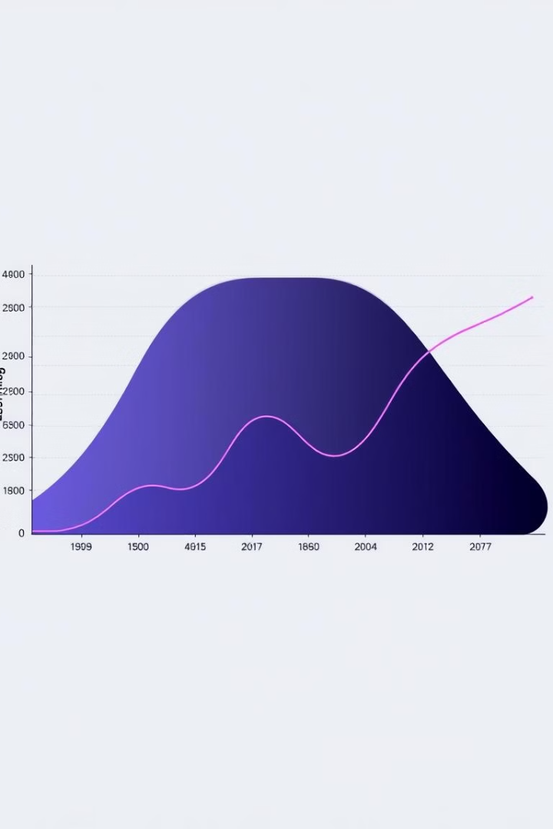
Learning Rate Management
1
Initial High Learning Rate
Training begins with a higher learning rate to allow for rapid convergence and large updates to model parameters.
2
Gradual Decrease
The learning rate is reduced over time, typically by a factor (e.g., 0.1) after a set number of epochs or when validation loss stops improving.
3
Fine-Tuning Phase
As training nears completion, a lower learning rate allows for fine-tuning of model parameters, ensuring precise adjustments without overshooting optimal values.

Slide 9
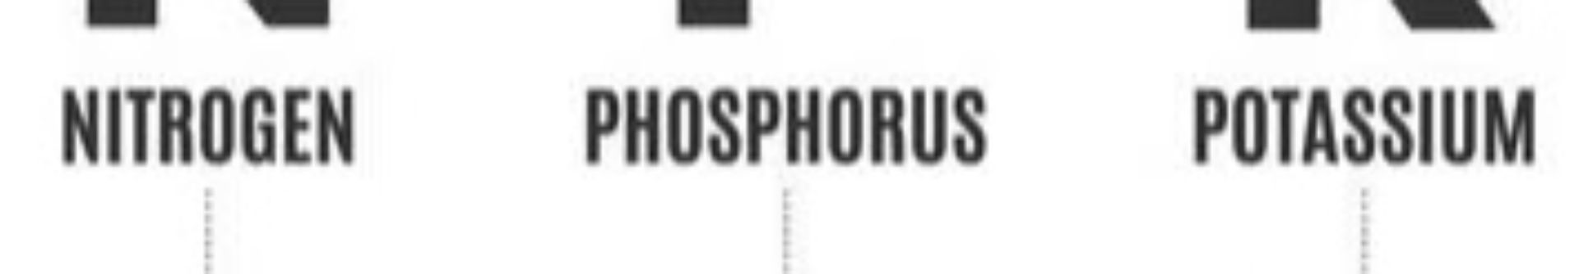
Crop Recommendation System: Overview
Data-Driven Recommendations
Enhanced Productivity
Analyzes soil nutrients (NPK) and geographical location to suggest optimal crops for cultivation.
Tailored recommendations maximize yield and reduce crop failure risk.
Sustainable Farming
Precision Agriculture
Promotes practices aligned with local soil and climate conditions.
Utilizes machine learning for accurate crop selection based on specific farm conditions.

Slide 10

Crop Recommendation System: Functionality
Input Collection
1
Gather soil NPK values and geographical location (state and city) from the user.
2
Data Analysis
Process input data using advanced machine learning models trained on historical crop performance and environmental data.
Weather Integration
3
Incorporate real-time and historical weather data from reliable API to enhance recommendation accuracy.
4
Recommendation Generation
Output tailored crop suggestions based on analyzed data, including planting time and care instructions.

Slide 11
Fertilizer Suggestion System: Overview
Precision Nutrient Management
Balanced Approach
Resource Efficiency
Optimizes crop productivity while minimizing environmental impact through tailored fertilizer suggestions.
Ensures efficient use of fertilizers, leading to cost savings and reduced environmental harm.
Provides detailed fertilizer recommendations based on soil nutrient profile and specific crop requirements.

Slide 12
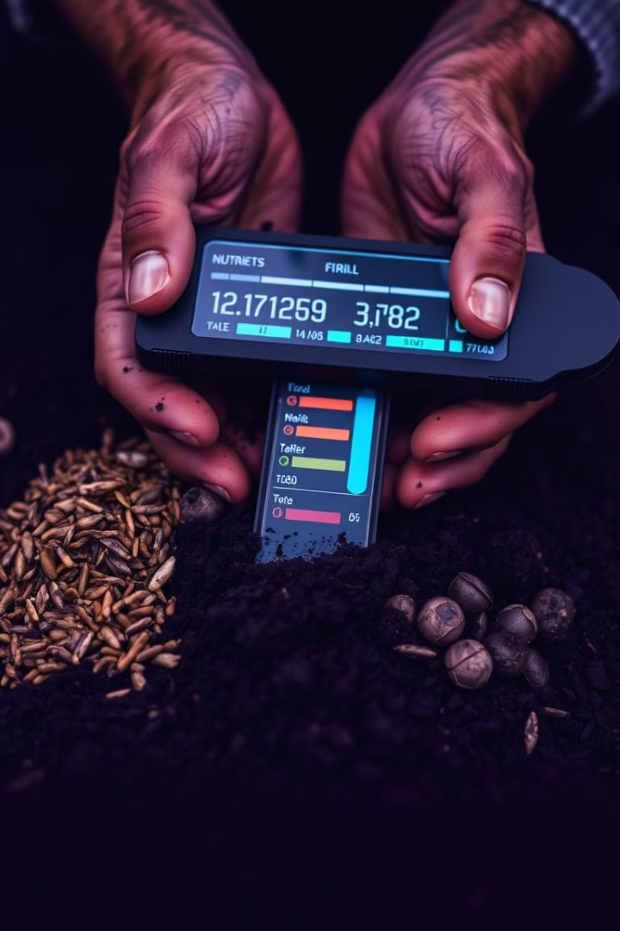

Fertilizer Suggestion System: Functionality
Input Collection
Gather soil nutrient content (NPK levels) and desired crop information from the user.
Data Analysis
Process input using machine learning algorithms trained on extensive soil and crop nutrient datasets.
Recommendation Generation
Output detailed fertilizer advice, specifying type and quantity needed to optimize soil health for the chosen crop.
Continuous Improvement
Adapt recommendations based on new data and farming outcomes to enhance future suggestions.

Slide 13





Technology Stack
PyTorch
NumPy
Pandas
Matplotlib
Open-source deep learning framework for building and training neural networks.
Library for numerical computing, facilitating array manipulation and mathematical calculations.
Data manipulation and analysis library used for preprocessing and handling datasets.
Visualization library for creating plots and graphs to analyze model performance.

Slide 14
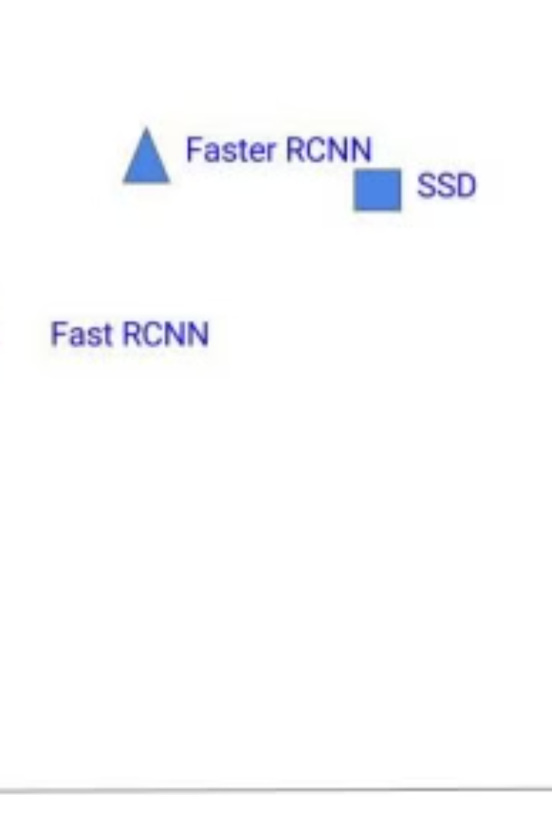
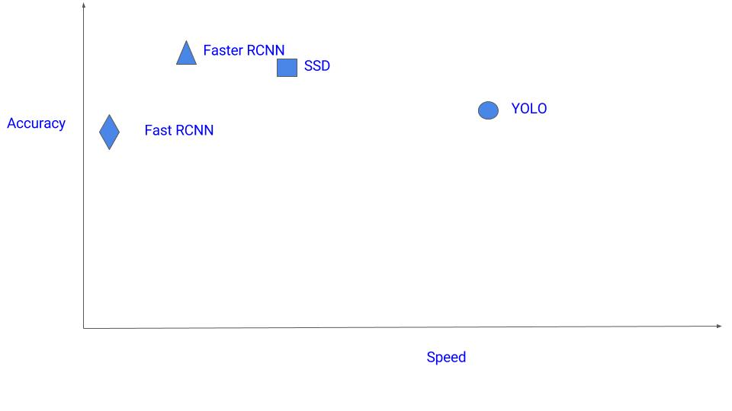
Comparison with Other Detection Algorithms
Algorithm
Speed
Accuracy
Scale Handling
Training Requirements
YOLOv3
Fast
Good
Excellent
Low
Faster R-CNN
Slow
Excellent
Moderate
High
SSD
Moderate
Good
Good
Moderate

Slide 15


ResNet Limitations
1
Data Requirements
ResNet models, especially deeper versions, require significant amounts of labeled training data to perform well, which can be resource-intensive to collect and annotate.
2
Computational Complexity
The depth of ResNet contributes to its high performance but also increases computational complexity, requiring powerful hardware and potentially long training times.
3
Overfitting Risk
Deep models like ResNet can overfit on small datasets, learning noise and details that do not generalize to new data, limiting its effectiveness with limited datasets.
4
Fine-Tuning Challenges
Fine-tuning a pre-trained ResNet model can be challenging due to its depth and complexity, requiring careful experimentation and validation.

Slide 16
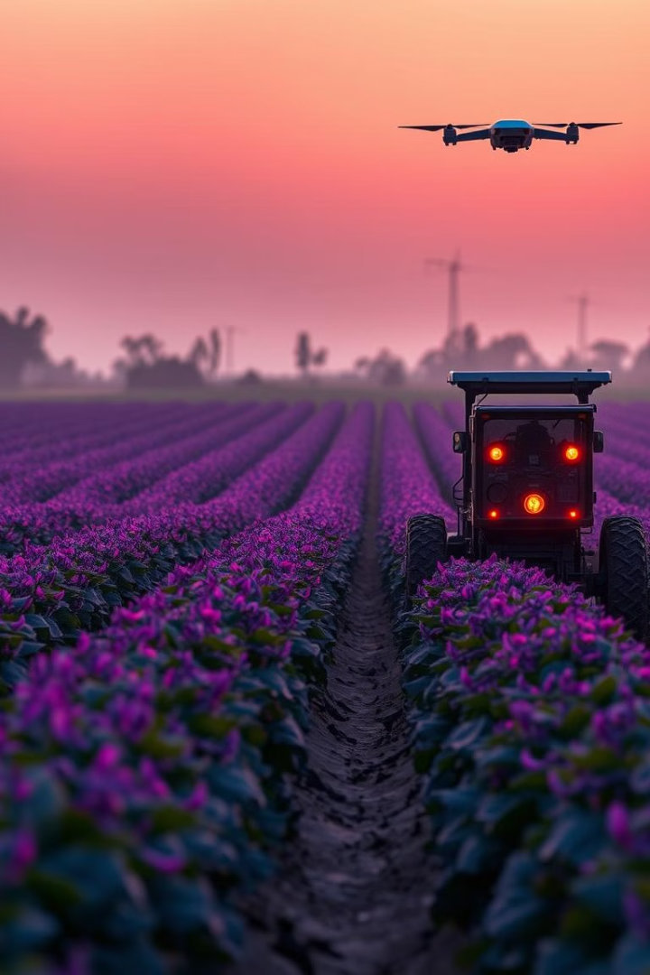
Project Impact and Future Directions
1
Agricultural Advancement
AgriSmart represents a significant step in integrating advanced technologies into agriculture, potentially revolutionizing farming practices.
2
Farmer Empowerment
By providing easy access to sophisticated tools and data-driven insights, the project aims to empower farmers to make informed decisions and improve crop yields.
3
Sustainability Focus
The application's recommendations for crop selection and fertilizer use contribute to more sustainable agricultural practices and resource efficiency.
4
Future Enhancements
Potential future developments could include integration with IoT devices for real-time monitoring and expansion of the disease detection capabilities to cover more plant species and conditions.

